Slide 1



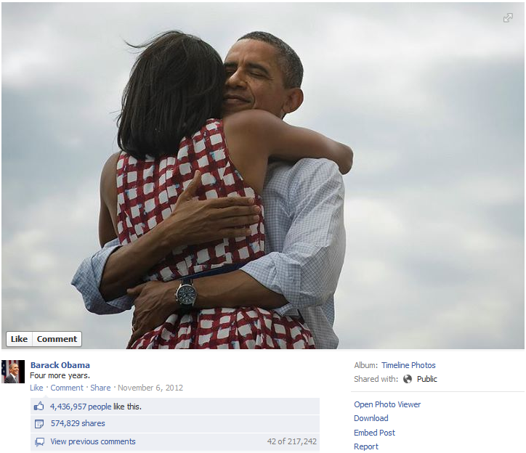
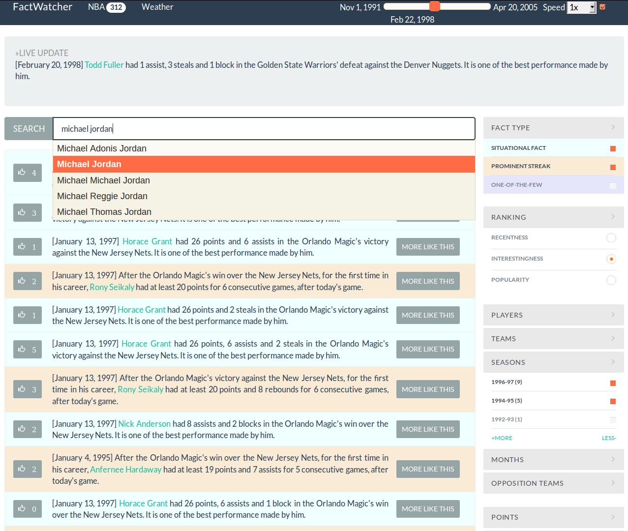
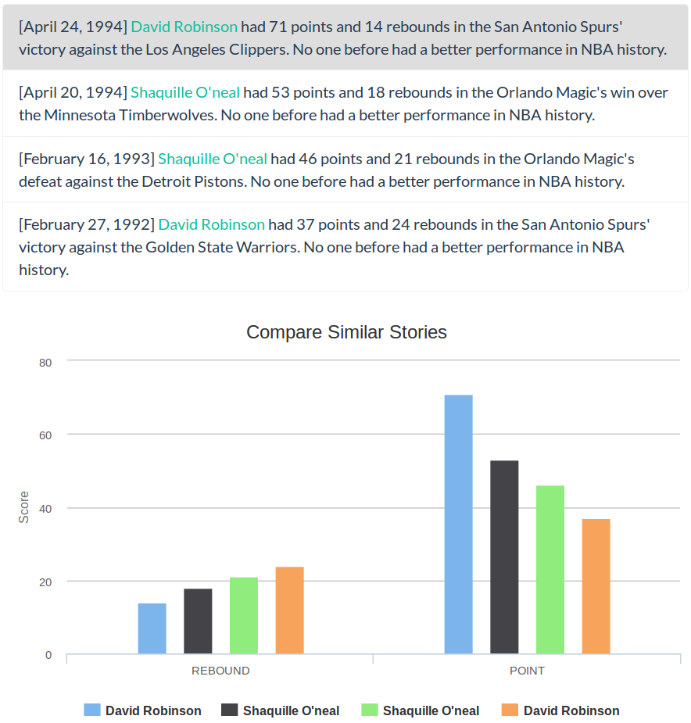
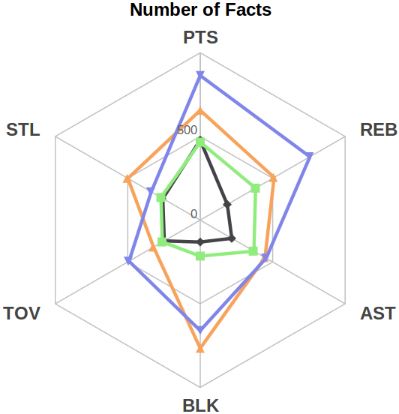
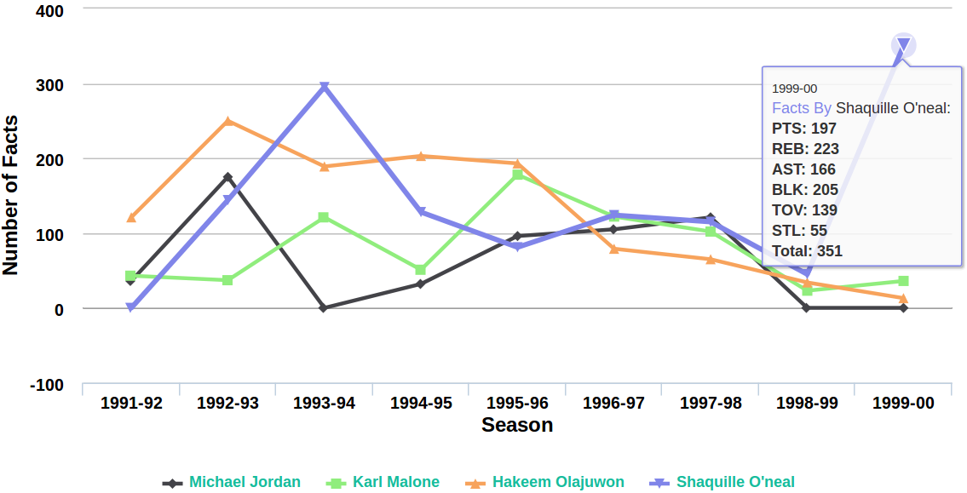
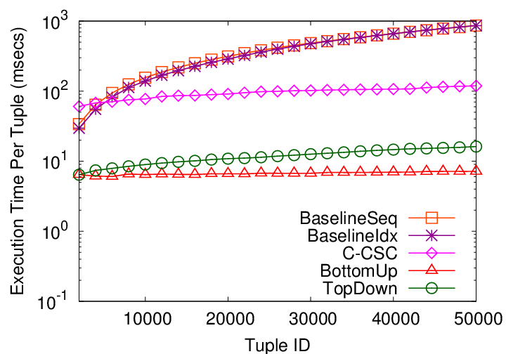






Data In, Fact Out: Automated Monitoring of Facts by FactWatcher
Naeemul Hassan¹, Afroza Sultana¹, You Wu², Gensheng Zhang¹, Chengkai Li¹, Jun Yang², Cong Yu³
¹University of Texas at Arlington, ²Duke University, ³Google Research
Motivation
FactWatcher GUI
Factual statements backed by data are leads to news stories:
Social Media: The social world’s most viral photo ever generated 3.5 million likes, 170,000 comments and 460,000 shares by Wednesday.
Weather: This month the Chinese capital has experienced 10 days with a maximum temperature in around 35 degrees Celsius—the most for the month of July in a decade.
Politics: Dick Durbin is one of the only three candidates who have raised more than 25% from PAC contributions and 25% from self-financing.
Concepts and Objectives
D
M
Append-only database R(D, M), latest tuple t
Dimension attributes D = {Player, Team, Season}
Measure attributes M = {Points, Assists, Blocks}
t = t₈: {Lamar Odom, Miami Heat, 2004, 30, 11, 11}
C: a conjunctive expression on D, M: a subspace of M
C: {Player = Lamar Odom, Team = *, Season = 2004}
M: {Points, Blocks}
Goal: Find 3 types of facts pertinent to the arrival of t
Situational Facts^{[2]}: (C, M) pairs where t is in the skyline
(C: {Player = *, Team = *, Season = 2004}, M: {Assists, Blocks})
Lamar Odom scored 11 assists and 11 blocks. No one made a better performance in season 2004 so far.
Prominent Streaks^{[3],[5]}: (C, M) pairs where t generates prominent streaks
(C: {Player = Lamar Odom, Team = 2004, Season = *}, M: {Length, Points, Assists})
Lamar Odom had at least 28 points and 9 or more assists for 4 consecutive games; the longest such streak in 2004.
One-of-the-Few Objects^{[4]}: (C, M) pairs where t is in the top-Ƭ skyband
(C: {Player = Lamar Odom, Team = *, Season = *}, M: {Points, Blocks})
Lamar Odom scored 30 points & 11 blocks. Only 2 other performances have ever beaten this record. The same claim can be made for three performance records only.
Id | Player | Team | Season | Points | Assists | Blocks
t₁ | Lamar Odom | LA Clippers | 2003 | 30 | 11 | 12
t₂ | Eddie House | Miami Heat | 2003 | 29 | 7 | 8
t₃ | Eddie House | Miami Heat | 2003 | 28 | 6 | 9
t₄ | Lamar Odom | Miami Heat | 2004 | 32 | 9 | 13
t₅ | Lamar Odom | Miami Heat | 2004 | 28 | 11 | 6
t₆ | Lamar Odom | Miami Heat | 2004 | 29 | 9 | 7
t₇ | Eddie House | LA Clippers | 2004 | 30 | 11 | 10
t₈ | Lamar Odom | Miami Heat | 2004 | 30 | 11 | 11
Similar Stories
Ranking
Facets
Main Interface
Comparison of Players
Experiment Results
Publications
Challenges
System Architecture
NBA dataset:
|D| = 5
|M| = 7
Data In, Fact Out. Automated Monitoring of Facts by FactWatcher. Hassan et al., VLDB 2014 demo.
Incremental discovery of prominent situational facts. Sultana et al., ICDE 2014.
Discovering general prominent streaks in sequence data. Zhang et al., TKDD 2014.
On one of the few objects. Wu et al., KDD 2012
Prominent streak discovery in sequence data. Jiang et al., KDD 2011
Huge space of possible facts
216 (C,M) pairs in the above tiny table.
Fast, monitoring algorithm for reporting facts.
Unified fact data model.
Unified fact ranking.
Facts
Rules &
Templates
Situational Facts
Prominent Streaks
Translation
Algorithms
One-of-the-Few Objects
Ranking
Database
Search
Funding
idir.uta.edu/factwatcher
Exploration
Stories
Analytics

